Slide 1
FINAL PROJECT
NUTRITION TRACKING DATABASE
DATABASE MANAGEMENT CSCI 3423
Dr. Darwish
Student Name: Saphalta Kumal
Monika Shrestha

Slide 2
1)Project Goal:
The main goal of the project Nutrition Tracking is to establish a system in place for the people who are wanting to consume low amount of calories and slimming down their bodies will be put on notice. This will help them to keep a record of their everyday routine, which will allow them to monitor their intense workouts and calculate their calorie intake. Monitoring the data might motivate the consumer to establish realistic goals and give them boost of energy to complete additional exercises. Therefore, this system moreover provides a valid continuous procedure.

Slide 3
2)Database Description:
The information is collected from all the client such as their name, DOB, height, weight, health status and so on are recorded for the initial phase to start the tracking of their nutrition data. After all the analysis, one database is created to know what food they are eating, calorie intake per day, calories burned per day, what kind of exercise do they perform and so on to keep them in their track. This database is created to help the client to monitor the status of their diet plan so they can workout to get the maximum success rate to keep them healthy. If they are out of their track this database will help them know what they are doing wrong and what food they should eat and the quantity of food they should be taking. Analysis of these data will also motivate the client to do more exercise and make the new data and they will be competitive to themselves.

Slide 4
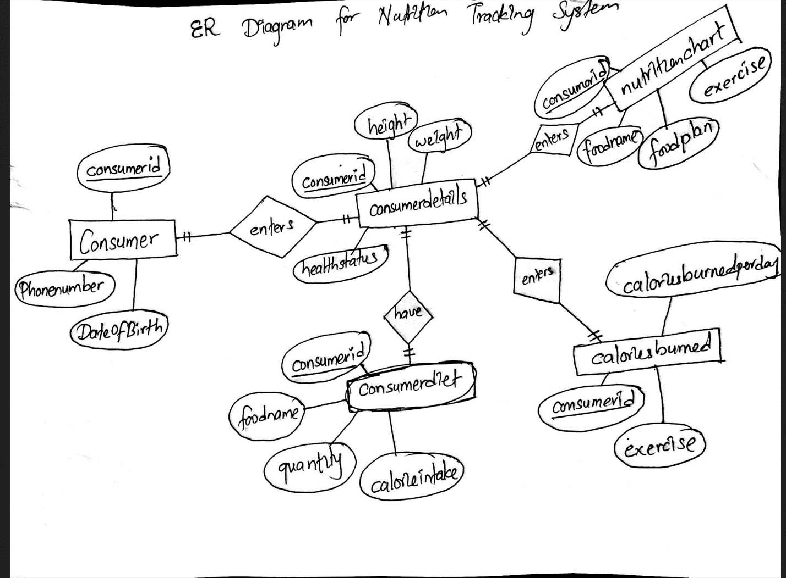
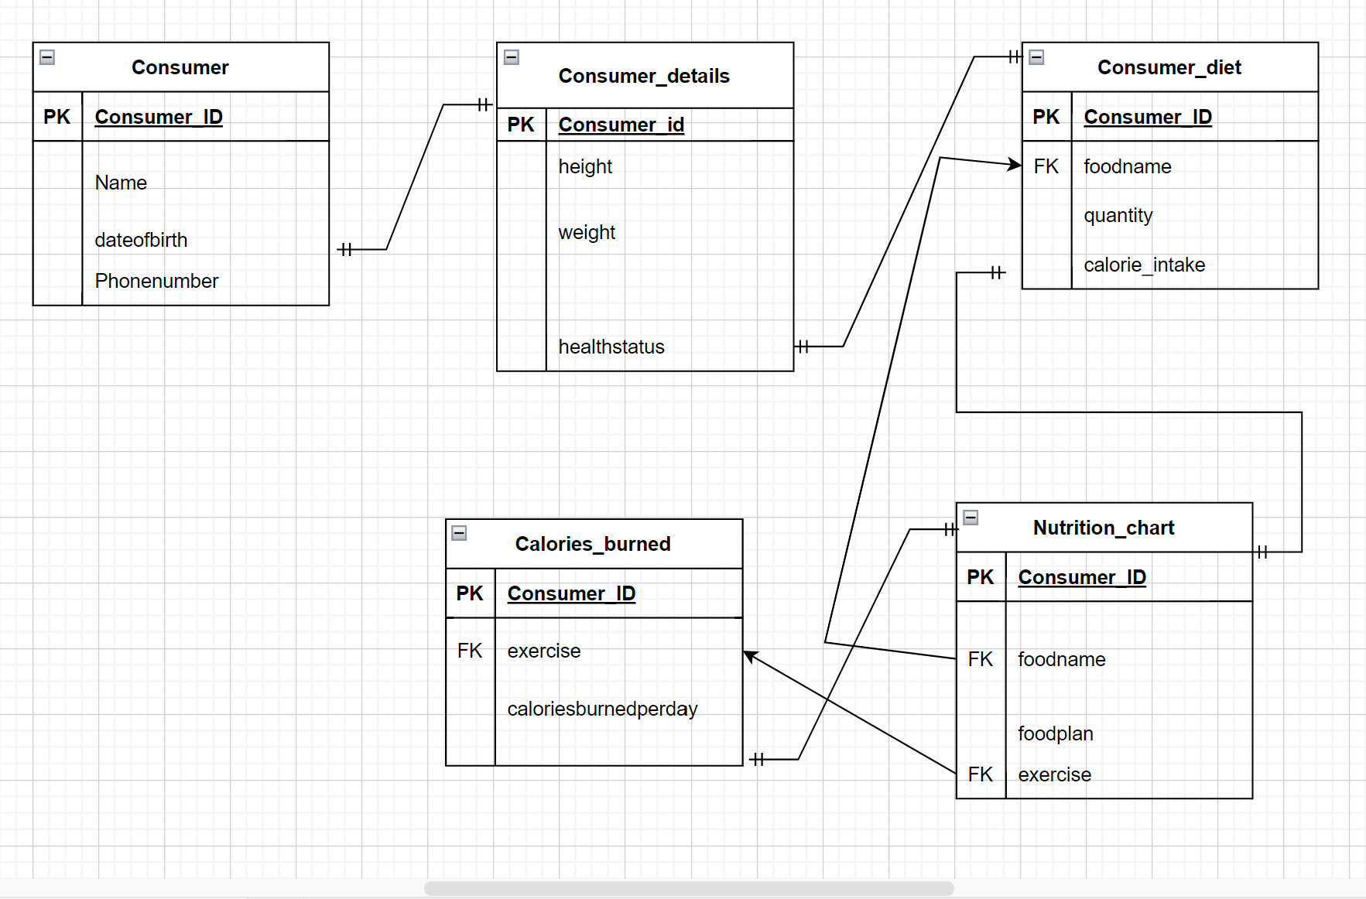
3)ER diagram:

Slide 5
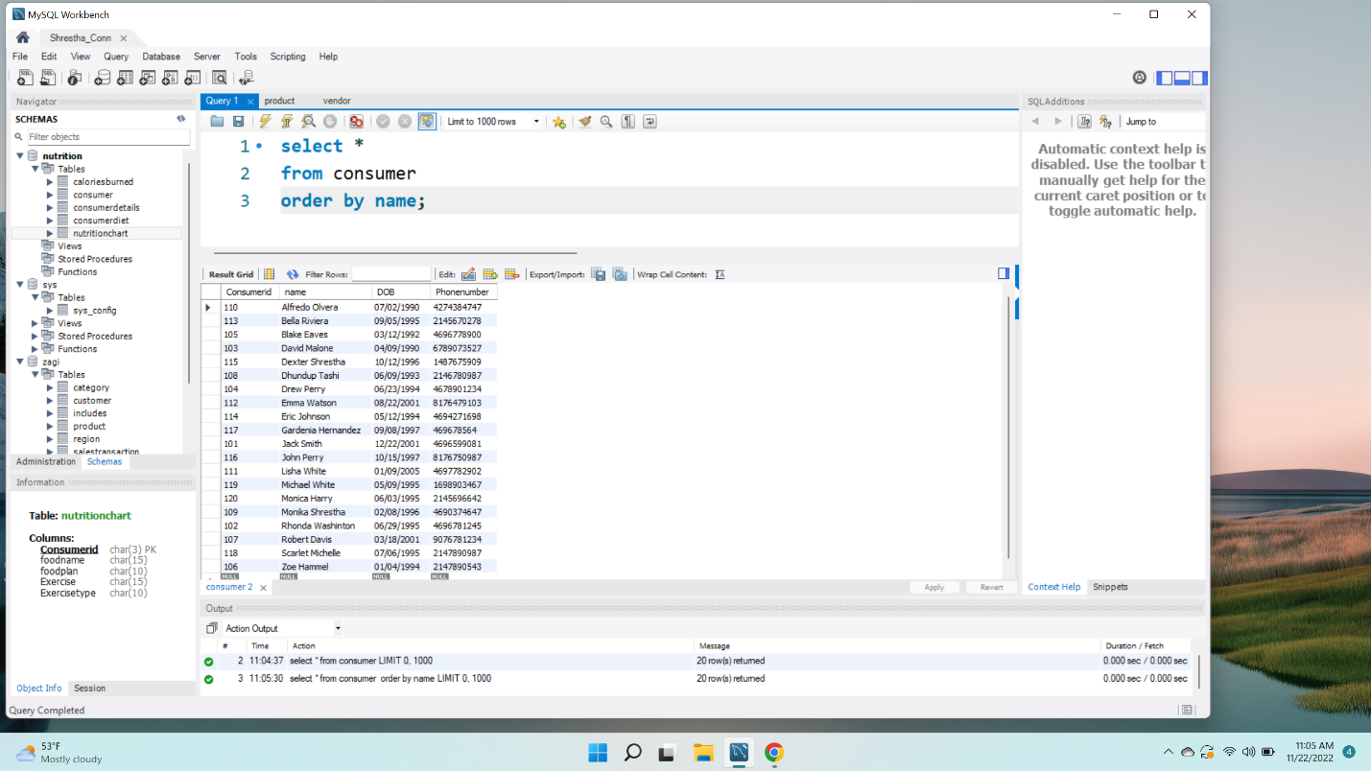
1 trivial query. Simple select with ordering. This query shows all the data under the consumer which is ordered by name which means as being a string value they are organized in alphabetical order.

Slide 6
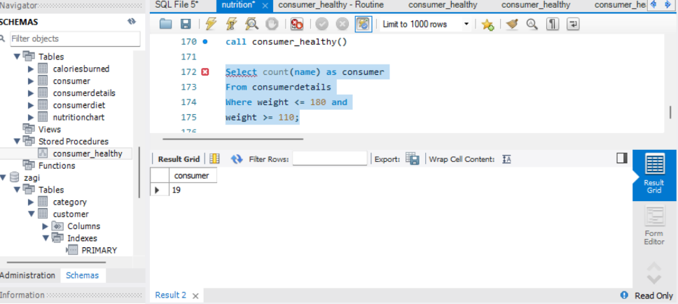
2 medium difficulty queries. Queries that use composite condition for selection, computations, aggregate function and grouping: The below given query provides the data of the number of consumers whose weight is in-between 110 and 180lbs. As, we can see 19 consumers have the weight between 110 and 180 lbs.

Slide 7
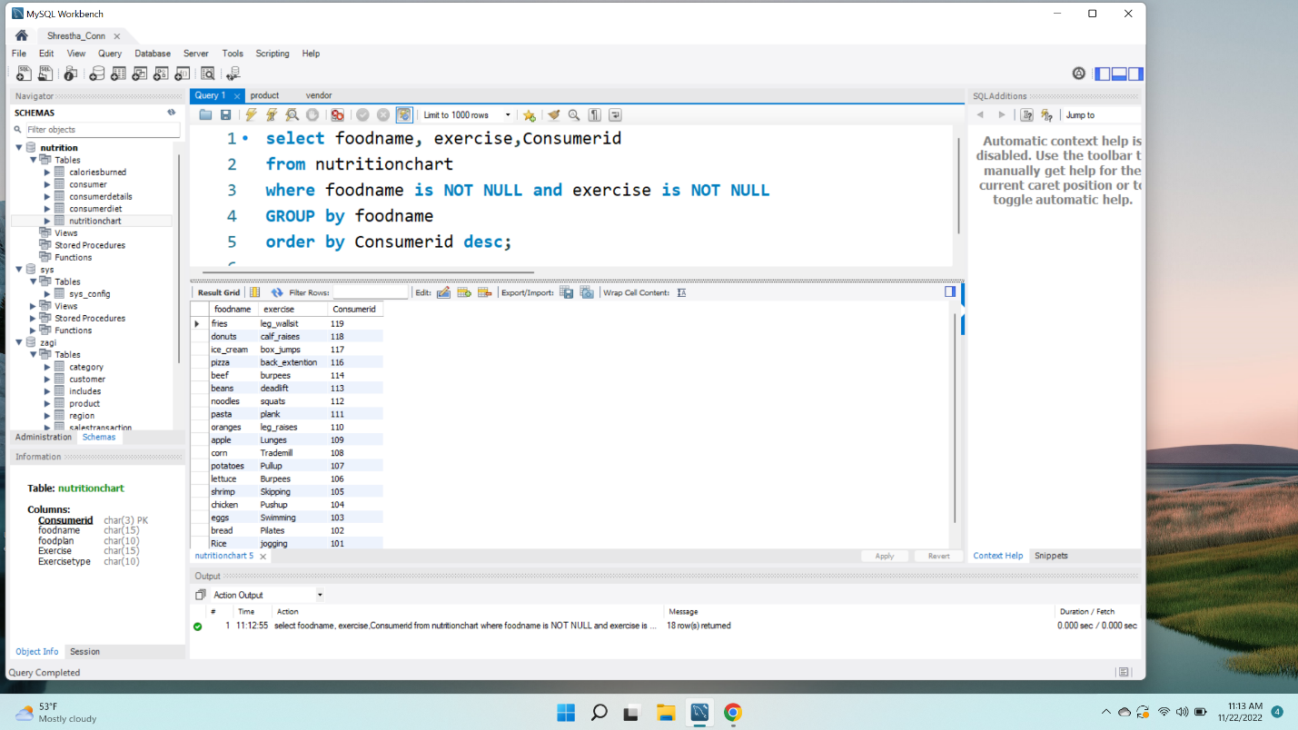
This query displays foodname, exercise and Consumerid from the nutritionchart table where foodname and exercise should have value and start with the foodname and consumer id should be displayed in a descending order.

Slide 8
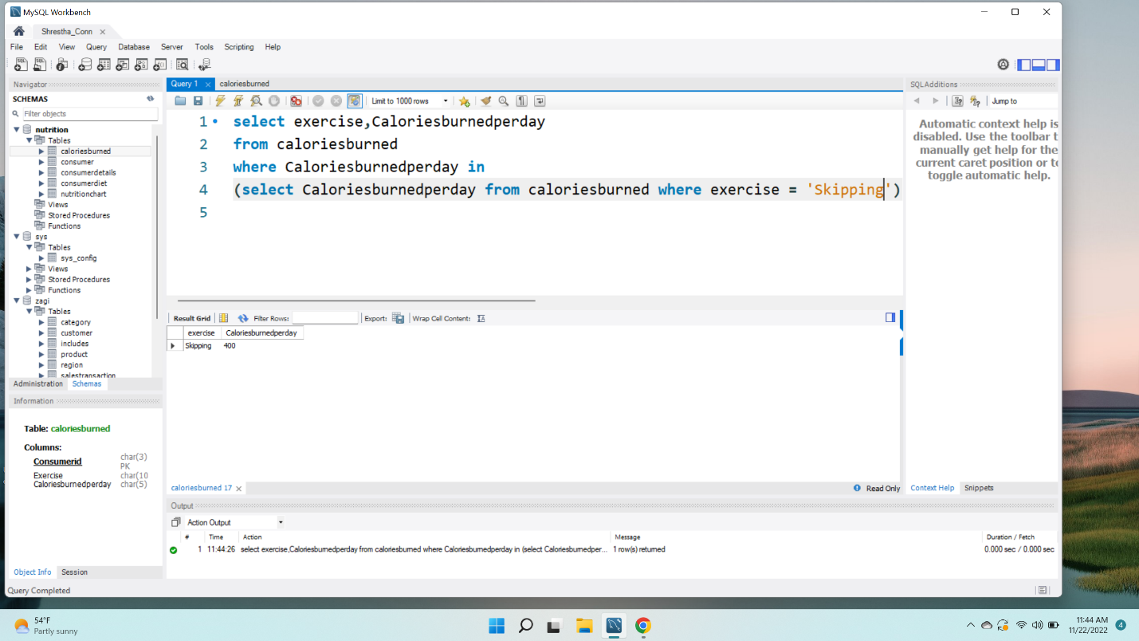
1 query that uses subquery This query displayed the exercise and caloriesburnedperday from caloriesburned table where exercise = ‘Skipping’. This query has subquery inside it.

Slide 9
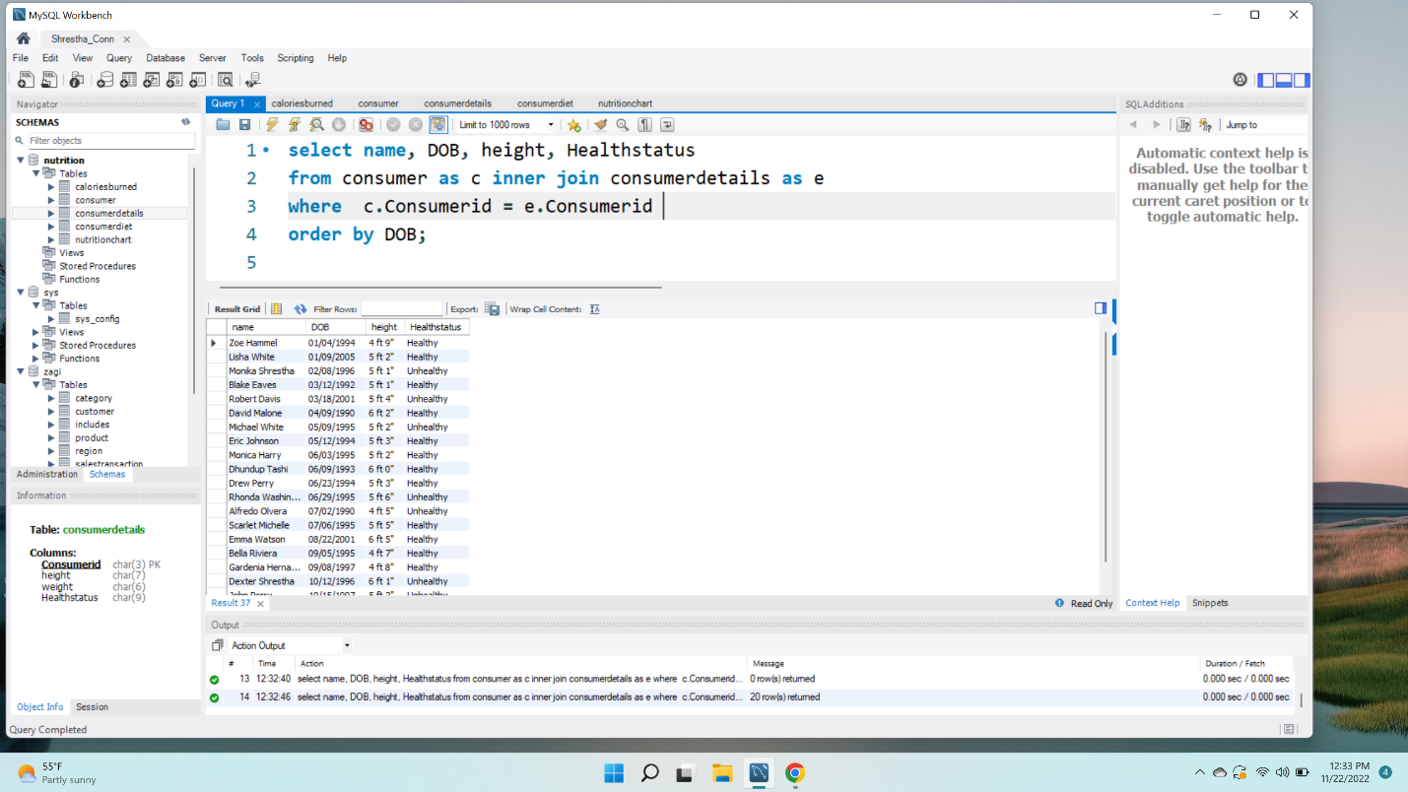
2 queries that uses join(1 inner join, 1 left or right outer join) This query displays name , DOB, height and healthstatus from consumer and consumerdetails using inner join where consumerid is primary key.

Slide 10
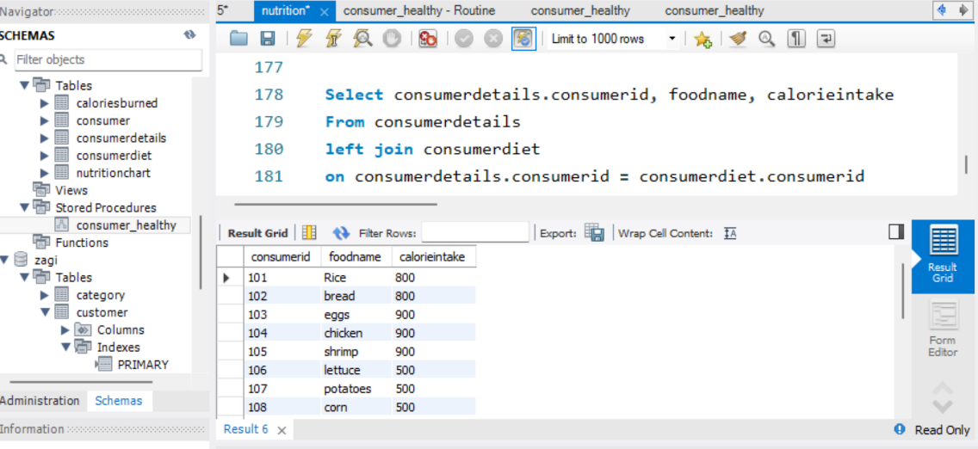
query that uses join ( left join ):
The left join provides both the related data out from the right table and every data from the left table. IN the below given query the consumer id, food name and caloriesintake from all consumers are displayed

Slide 11
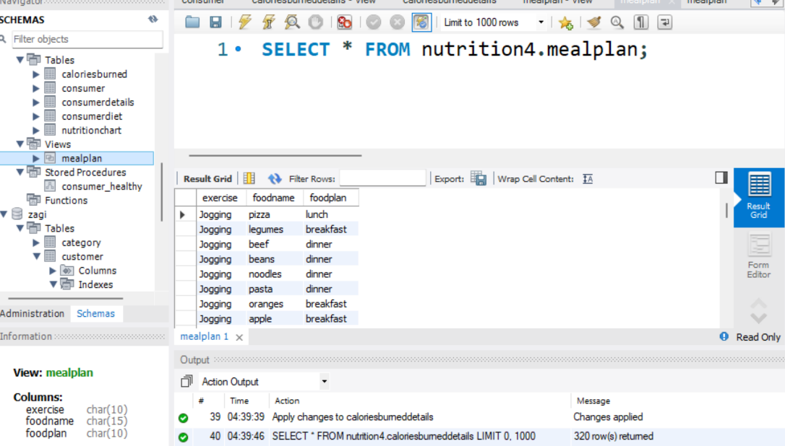
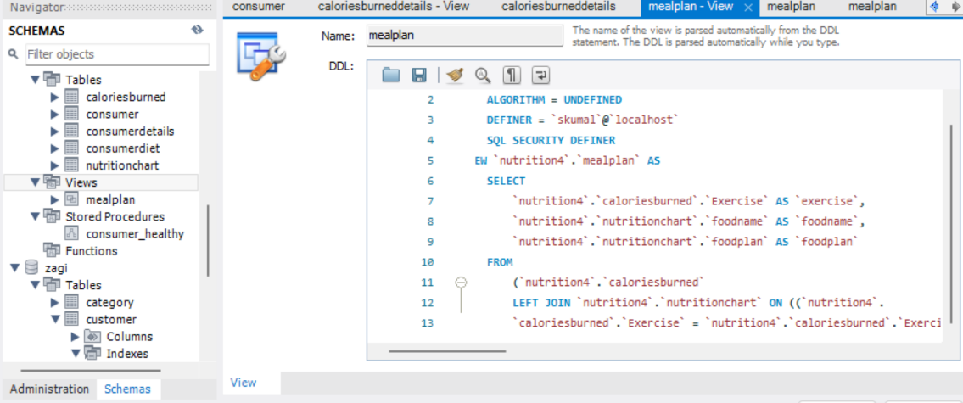
1 view (query must use join):
We use View to have a query with a join condition. The below given query shows what exercises are done by the consumer, what food they ate, and when they ate eg: did they ate during breakfast, lunch or dinner.
CREATE VIEW `caloriesburneddetails` AS
CREATE VIEW `caloriesburneddetails` AS
Select caloriesburned.exercise, foodname, foodplan
From caloriesburned
left join nutritionchart
on caloriesburned.exercise = caloriesburned.exercise

Slide 12
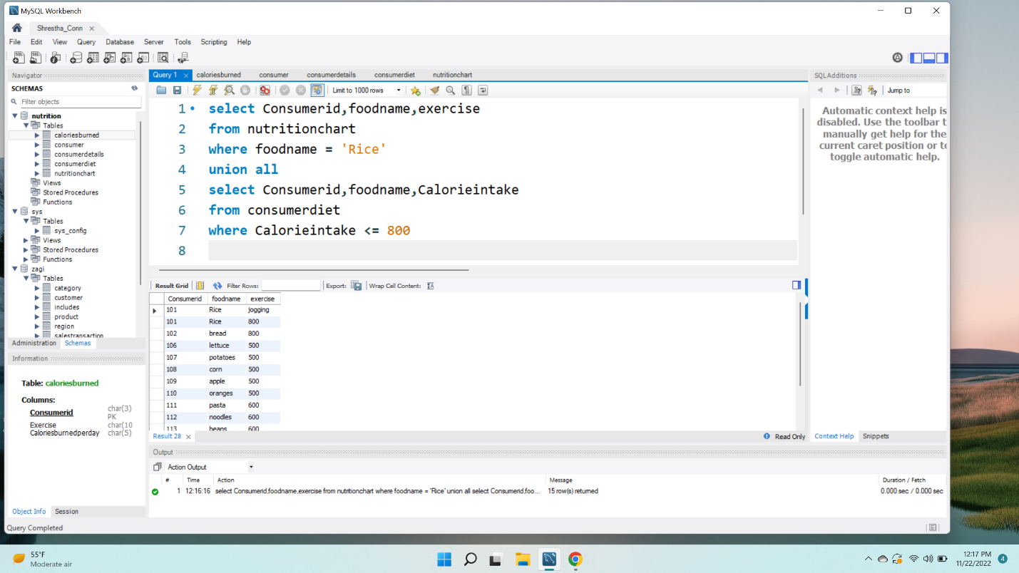
1 query that uses union
This query has combined two tables nutritionchart and consumerdiet using union. But there is criteria to pull just the foodname = ‘Rice’ from nutritionchart and from consumerdiet just display the result which calorieintake is less than 800.

Slide 13
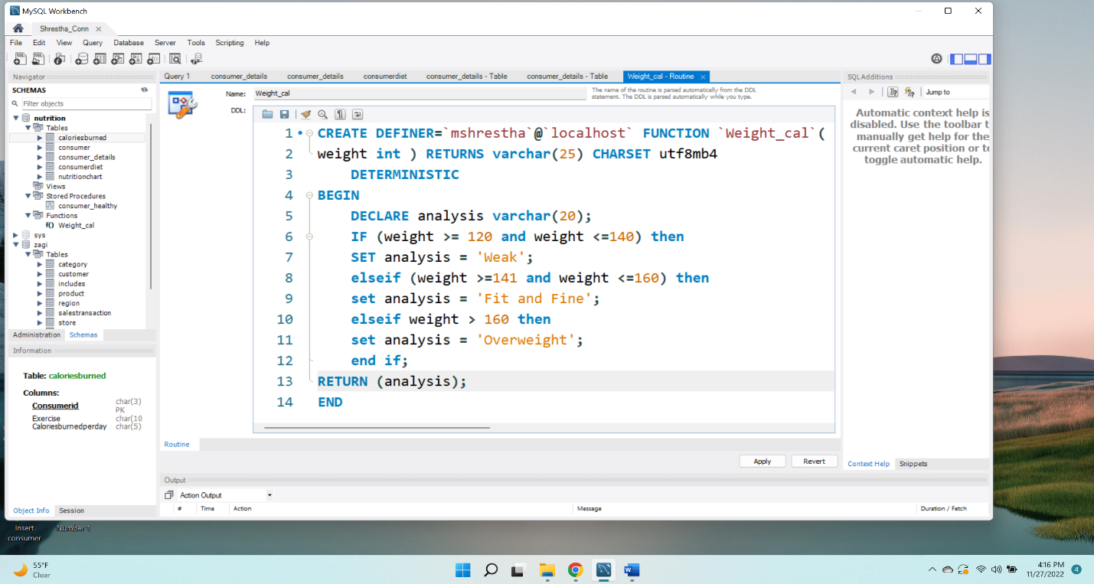
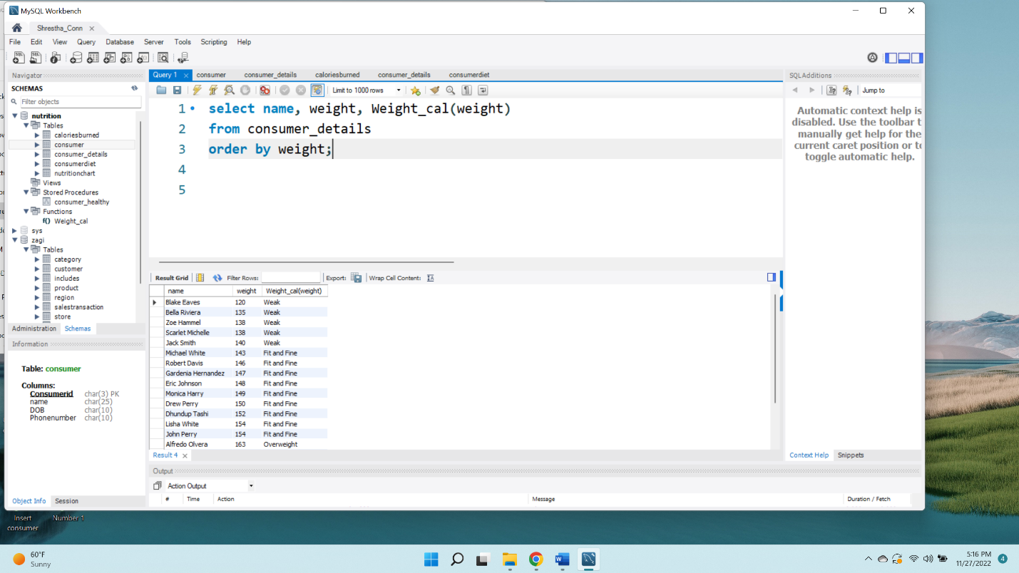
1 custom stored function
Here the function is created first with the criteria about the weight in consumerdetails. This query displays the name, weight and it calls the weight_cal from the stored function. It calculates the criteria where if the weight is in between 120 and 140 then the client is weak, if the weight is in between 140 to 160 then they are fit and fine and the weight over 160 are overweight.

Slide 14
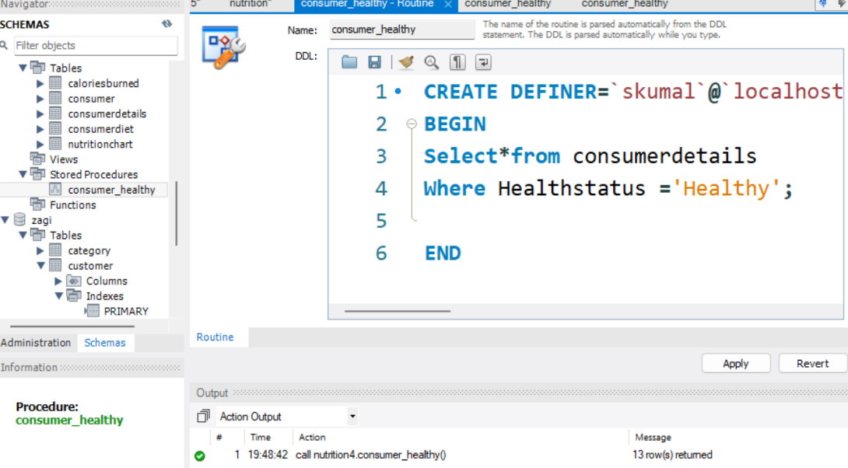
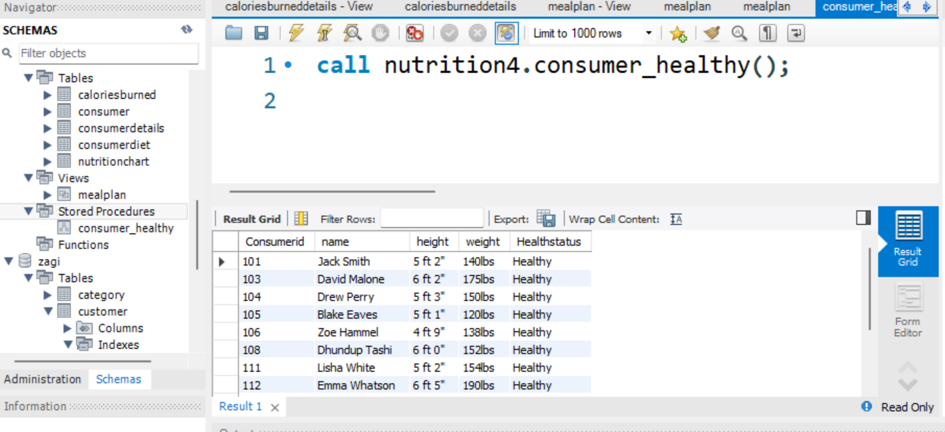
1 custom stored procedure:
A prepared SQL code called a stored procedure is a code that can be saved and used repeatedly.
The below shown query shows the consumerid, name, height, weight of the consumers who are healthy.

